Slide 1
Evaluating World Economies:
A Strategic Search for Optimal Investment Opportunities
Zainab Alhashemi
General Assembly - Capstone

Slide 2
Table of contents
01
Introduction
02
Problem Statement
03
Aim
04
Objectives
05
Target Audience
06
Data Overview & Limitations
07
Exploratory Data Analysis
08
Approach
09
Analysis & Findings
10
Recommendation

Slide 3
Introduction
Choosing the right global economy to invest in is challenging due to shifting markets and varying growth rates.
This project analyzes major world economies to identify the strongest investment destination outside Bahrain, using data-driven metrics and financial performance indicators.

Slide 4
Problem Statement
Inexperienced Investors lack a clear, data-based comparison of global economies to determine where to invest outside Bahrain.

Slide 5
Aim
This project aims to identify the best economy for investment by analyzing growth, stability, and market performance.

Slide 6
Objectives
Which financial indicator is most important when evaluating foreign investment opportunities?
What type of Markets are appropriate for inexperienced investors?
How can currency exchange rates impact an investment?
What investment options are suitable for beginner investors?

Slide 7
Target Audience
Individuals that want another source of income
Investors that want to expand their portfolios overseas

Slide 8
Data Overview
The dataset (Global Economic Monitor) published by the World Bank Group includes multiple financial indicators on global economic developments
Annual Exchange Rate in Local Currency per USD
Annual GDP at Market Prices in Constant USD
Total Value of Stocks Traded in USD
Quarterly GDP at Market Prices in Constant USD
Limitations: Data for all countries in the Gulf was not available in every financial indicator

Slide 9
Exploratory Data Analysis (EDA)
+199 Economies
+30 Years of Data
Annual & Quarterly Values
Figures in USD
Figures in Local Currency

Slide 10
Approach
Broad Market Analysis
Analyzed the 3 most common economies
Country Analysis
Identified the countries with the highest growth rate
Stock Market Analysis
Identified the country with the most growing stock market
Currency Analysis
Analyzed Currency fluctuations
Recommendation
Identified potential stocks for investment

Slide 11
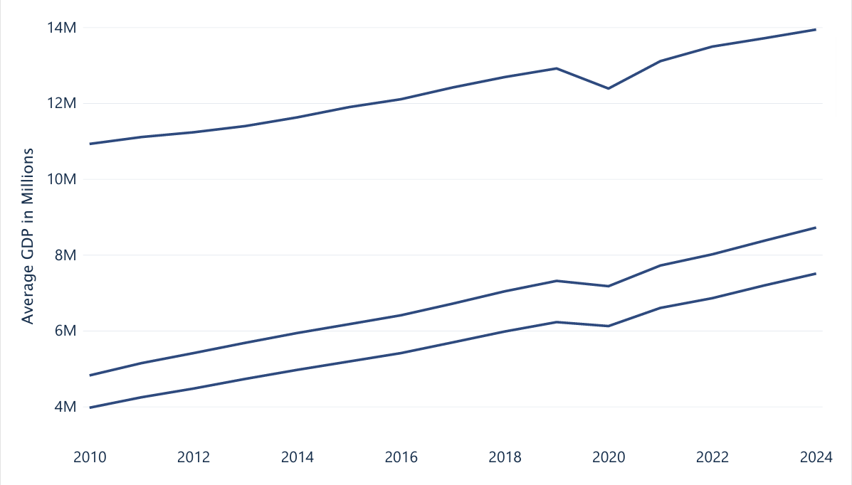
Most Common Economies For Investing
Advanced Market Economies
Emerging Market Economies
Middle Income Market Economies
Advanced economies declined more sharply than emerging markets, making emerging economies the stronger and more accessible investment choice.

Slide 12
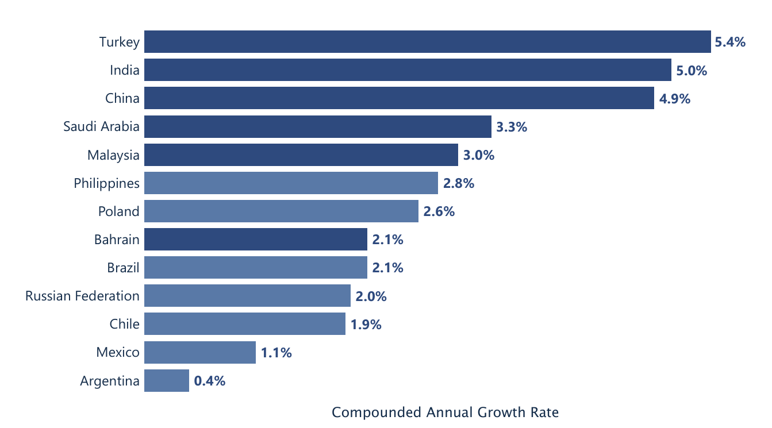
Growth Rate of Top Emerging Economies From 2019-2024
D
D
D
D
D

Slide 13
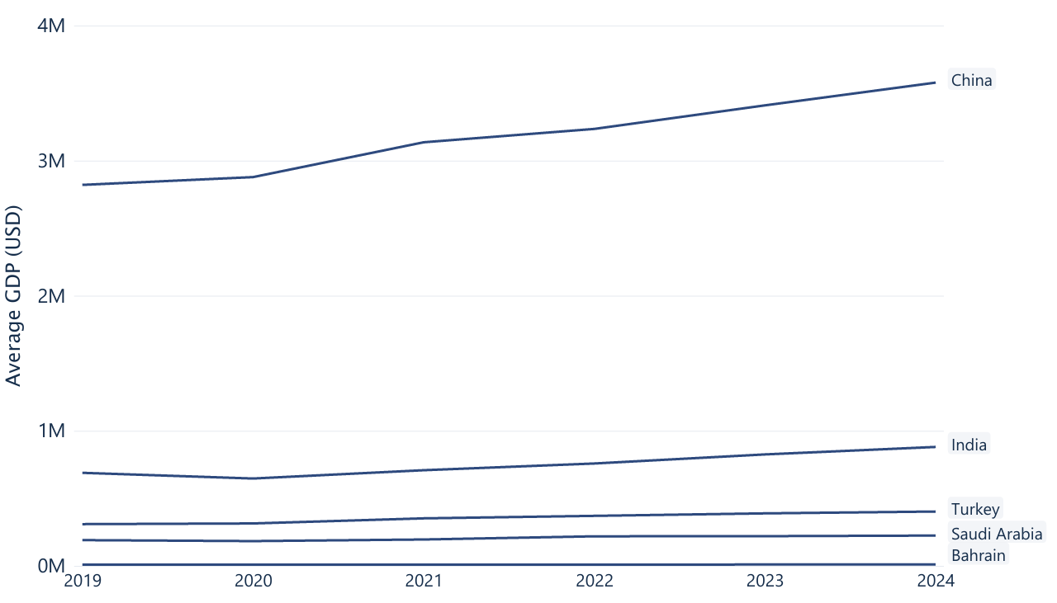
Top Emerging Economies GDP Analysis
(Values are in Millions)
China has shown to have the highest GDP over the past 5 years while Bahrain had the lowest

Slide 14
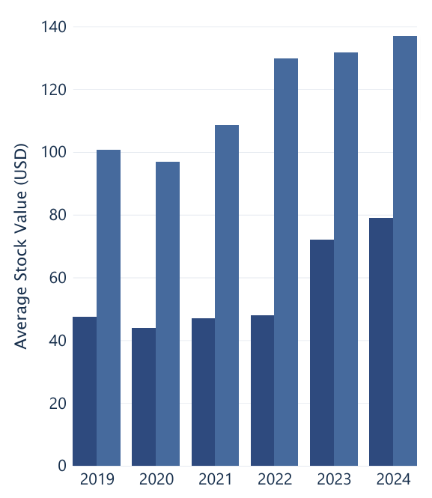
Turkey - Market Analysis
Turkey
Bahrain
Average Stock Market Value of Turkey vs Bahrain
Local shares have higher average value than Turkey’s stock exchange.

Slide 15
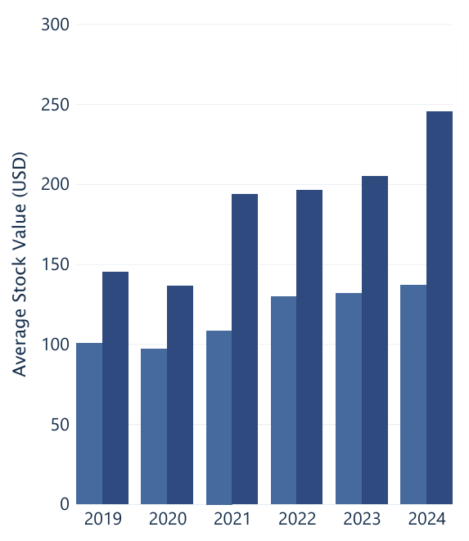
India - Market Analysis
India
Bahrain
Average Stock Market Value of India vs Bahrain
India has a higher more growing economy & a stronger stock market than Bahrain.

Slide 16
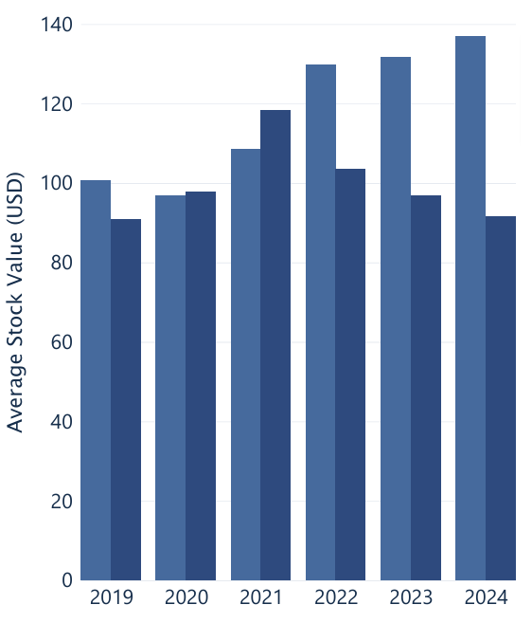
China - Market Analysis
China
Bahrain
Average Stock Market Value of China vs Bahrain
China has higher GDP than Bahrain, however Bahrain has a stronger stock market.

Slide 17
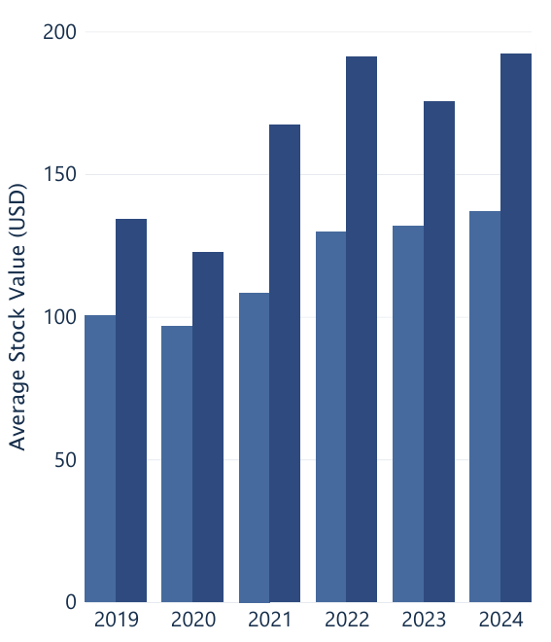
Saudi Arabia - Market Analysis
KSA
Bahrain
Average Stock Market Value of KSA vs Bahrain
Saudi Arabia has a stronger more growing stock market than Bahrain

Slide 18
Currency Analysis
Currency Growth Rate Per USD from 2019-2024
48%
19%
4%
0%
Turkish Lira
Indian Rupee
Chinese Yuan
Saudi Riyal
A currency appreciates if it takes more of another currency to buy it, and depreciates if it takes less of another currency to buy it.

Slide 19
Recommendation
Saudi Arabia is the 4th most growing economy based on analysis.
Doesn’t have any currency fluctuations in the past 5 years.
Has huge stock market growth.

Slide 20




Stocks To Target
Based on research, KSA’s stock market, Tadawul, offers both stable dividend stocks and high-growth options aligned with Vision 2030, making it attractive to both conservative & aggressive investors.

Slide 21
Thank You!

